Slide 1
UNITS OF SOCIETY
NAME:TANISHA SINHA
ROLL NO:48
BRANCH:DATA SCIENCE

Slide 2

WHAT IS SOCIETY?

Slide 3
A society is a group of individuals involved in persistent social interaction, or a large social group sharing the same spatial or social territory, typically subject to the same political authority and dominant cultural expectations.

Slide 4
SOCIETY
STATUES AND ROLES
SOCIAL INSTITUTES
SOCIAL GROUPS
ASCRIBED STATUS
EMERGENT
ACHIEVED STATUS
SECONDARY GROUPS
TRADITIONAL
PRIMARY GROUP

Slide 5
SOCIETY IS BROADLY CLASSIFIED AS:

Slide 6
1.SOCIAL INSTITUTIONS:
A social institution is an interrelated system of social roles and social norms, organized around the satisfaction of an important social need or social function. • Social Institutions are organized patterns of beliefs and behaviour that are centered on basic social needs.

Slide 7
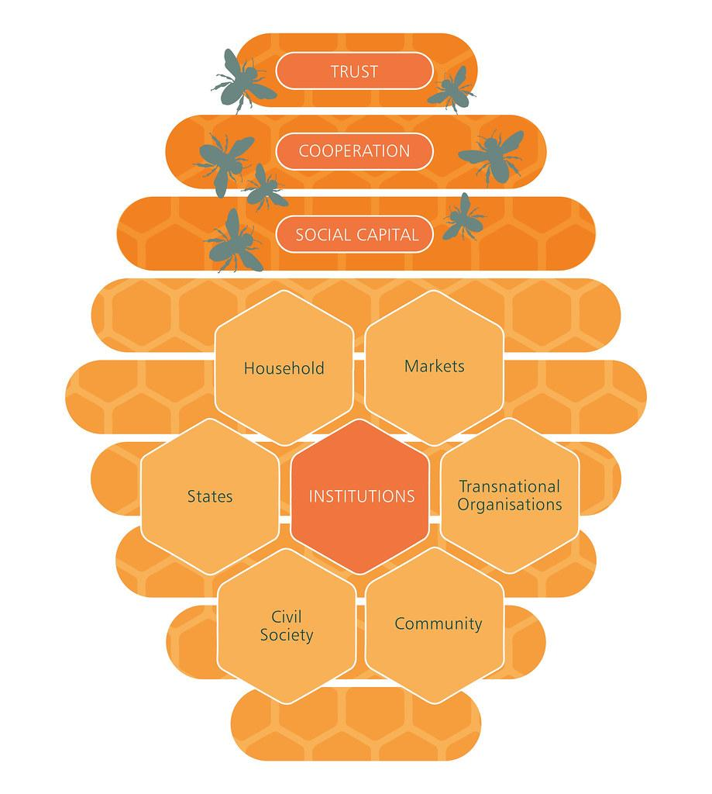
Characteristics of Social Institutions:
1) impose functions.
2) have deontic properties.
3) has a distinction between constitutive and regulative rules.
4) has collective intentionality.

Slide 8
Major five types of social institutions:

Slide 9
1.RELIGION
Religion has crossed boundaries and cultures and still exists as a major social institution in the 21st century. Religious beliefs help individuals cope with abstract concepts such as life and death.Religious institutions such as churches, temples and mosques have codes of conduct that extend to the life outside of these sacred areas. There are certain norms and rules one must follow in order to be accepted by the people of the community. If these norms are broken, individuals will face consequences such as ostracisation and shunning from the community. Religion deeply influences the way one thinks and acts so it performs a far greater role than being a place of worship. In countries such as India, religion deeply influences politics and one’s standard of living.

Slide 10
2. Family
The family is where primary socialisation takes place, it is considered an important part of development and structures the way one lives. Values, morals and beliefs taught during the ages of 4-18 have a direct and observable impact on how a child views and reacts to the world. It is beyond just raising a child.

Slide 11
The definition of what constitutes a family has changed over history but the characteristics remain the same, it is
1) A mating relationship,
2) A form of marriage,
3) A system of nomenclature,
4) A means for the economic provision and
5) Involves common habitation.
The family and society are interconnected as families combined to constitute a society. Parents are not only tasked with the responsibility of raising their child, but also socialising them to adhere to the norms and rules of the society they live in. They must also teach children about the different cultures that exist and the proper etiquette to follow in different situations. Parents share information with children that were passed down from their parents.

Slide 12
3. Education
Schools are an important part of a child’s growth and development, that is why people emphasise the need to send children to physical schools rather than homeschooling them. During the sixteen years at school, children imbibe values and knowledge that exist outside the official curriculum. This is often referred to as the hidden curriculum. Rules and norms that were taught by parents and religious institutions are reinforced, along with this they learn new rules that can only be taught at an institution such as the school.

Slide 13
For example, the idea that one must not cheat to gain merit can only be truly taught in a school setting. Educators teach children to be kind, to learn to work together, to work hard for good results and so on. When children engage in acts such as bullying and harassment, they are punished for their bad behaviour. Schools help children transition from their safety net into the real world where they are held responsible for their actions.

Slide 14
4. Politics
As Robert Dahl stated, politics is an unavoidable facet of human existence, because regardless of time and culture, humans are involved in some political system or the other. They may not resemble each other but a system exists. It is needed because in order to function properly and have stability a set of rules and regulations that govern the masses is required. Politics can be understood as the method through which we mobilize resources appropriately and appoint individuals with power to make decisions. In order for society to function and continue fucntioing over generations, it is crucial that the people are willing to accept collective norms and regulations. Each generation must be willing to abide by the basic rules of that society or come to a general consensus of decision-making. Political socialisation, therfore, is an important role that these institutions play. They must ensure that the members of society acquire political attitudes and actively participate in political decision-making.

Slide 15
5. Media
Media can influence how people perceive other institutions such as gender, marriage, and religon as well. For example, the constant projection of Islam as a harmful religion feeds into the minds of islamophobes and convinces the general population that the core ideologies of this religion is bad. While the media exists to transfer and spread information, it reinforces norms, values and beliefs that bound the walls of society.

Slide 16
2. SOCIAL GROUPS :
A social group can be defined as two or more people who interact with one another, share similar characteristics, and collectively have a sense of unity. Regardless, social groups come in a myriad of sizes and varieties. For example, a society can be viewed as a large social group.

Slide 17
TYPES OF SOCIAL GROUPS:

Slide 18
Primary Groups:
No two groups are created equal. Each typically has its own purpose, culture, norms, etc. Sociologists differentiate between several different types of social groups. In this lesson, we'll discuss primary groups, secondary groups, and reference groups. Primary groups are those that are close-knit. They are typically small scale, include intimate relationships, and are usually long lasting. The members of primary groups feel a strong personal identity with the group.

Slide 19
EXAMPLE:
Although the nuclear family is considered the ideal primary group by some sociologists, it is not the only example. Many people are also a member of a group of close friends. This group is usually small, and the relationships are still close-knit and enduring, so it is also a primary group. The term 'primary' is used with these groups because they are the primary source of relationships and socialization. The relationships in our primary groups give us love, security, and companionship. We also learn values and norms from our family and friends that stay with us for most, if not all,of our lives.

Slide 20
Secondary Groups
Secondary groups are another type of social group. They have the opposite characteristics of primary groups. They can be small or large and are mostly impersonal and usually short term. These groups are typically found at work and school. An example of a secondary group is a committee organized to plan a holiday party at work. Members of the committee meet infrequently and for only a short period of time. Although group members may have some similar interests, the purpose of the group is about the task instead of the relationships. Sometimes, secondary groups become pretty informal, and the members get to know each other fairly well. Even so, their friendships exist in a limited context; they won't necessarily remain close beyond the holiday party.

Slide 21
3.STATUSES AND ROLES:
In all of the many social groups that we as individuals belong to, we have a status and a role to fulfill. Status is our relative social position within a group, while a role is the part our society expects us to play in a given status. For example, a man may have the status of father in his family. Because of this status, he is expected to fulfill a role for his children that in most societies requires him to nurture, educate, guide, and protect them. Of course, mothers usually have complementary roles.

Slide 22
TYPES OF STATUSES AND ROLES:

Slide 23
I. ACHIEVED STATUES:
A man’s status can be broadly determined by many factors.Caste, creed, sex, position in any institution are some of the factors which determine the status of a man. Status of a man is a temporary thing. It can be changed according to the situation. As the name says achieved, it means a person had worked hard to achieve a status in a society. Position in any institution is an example of Achieved status. If he gets promoted to a new level, his status is changed in the society.

Slide 24
II.ASCRIBED STATUS
Ascribed status in society means a status which is not achieved on the basis of merit or skills. It is something which you are assigned by birth. Many of the statuses which are assigned by birth are due to sex, caste or age in many of the countries. Ascribed status does not get good along with the society as compared to the achieved status. Many dreams and abilities have failed even before they have tested due to the ascribed status of society.

Slide 25
Also ascribed status does not change according to a situation like achieved status. For example, a king’s first son will be the next heir no matter what. It is neither done on merit level nor the choice is made by the prince whether he truly wants to be king or not.

Slide 26
THANK YOU

